Slide 1
“How To Do Business With Metra”
Ground Rules for Today
Mute Microphone
Turn Off Video
Submit Questions via Chat Box

Slide 2
Agenda
Opening Remarks
DBE Certification
Procurement Services
DBE Compliance
Questions
Closing Remarks

Slide 3
DBE Certification
Presented by Michele Sutton, Sr. DBE Certification Specialist

Slide 4
DBE Overview
What is a DBE?
Ownership
An independent business that is at least 51 percent owned by a socially or economically disadvantaged individual(s)
The socially or economically disadvantaged individual(s) include:
Women, Native Americans, African Americans, Hispanic Americans, Asian-Pacific Americans and Subcontinent Asian Americans
Personal Net Worth (PNW)
Majority owner personal net worth must not exceed $1.32 million
Control
The majority owner must control the management and daily operations
Size
A for-profit business that meets the Small Business Administration’s (SBA) size standard and does not exceed $23.98 million in gross annual receipts over a three year average

Slide 5
DBE Overview
Different agencies recognize different certifications
DBE Certification is:
Federal Requirement
United States Department of Transportation (US DOT) contracts for highway, transit, and airport
M/WBE Certification is:
State and local government contracting authorities

Slide 6
DBE Overview
DBE Certification through one of these agencies is recognized by all
The Illinois Unified Certification Program (IL UCP) directory provides a reference source of certified DBE firms. The Directory lists the firms in alphabetical order, including the NAICS codes* and specialties. The Directory provides a reference source to assist bidders/proposers in meeting DBE contract goals.
*North American Industry Classification System (NAICS) Codes – classification of the specialties or services that a firm seeks
to perform.

Slide 7
DBE Overview
Advantages of DBE Certification
Company listed in the IL UCP DBE vendor directory
An opportunity to participate on federally funded or assisted projects as prime contractors or subcontractors
An identifier that can be used as a marketing tool for businesses

Slide 8
DBE Certification Process
Determining Eligibility
The certification application, Personal Net Worth (PNW) statement and supporting documents are analyzed.
A site visit is conducted to verity the firm’s business, which includes a tour of the facility and photographs.
A final determination is made on whether or not the firm is eligible for DBE certification and the firm is notified via mail.
The DBE Program complies with the US DOT 49 CFR, Part 26, Subpart D, which provides the certification guidelines and procedures.
Process takes 60 to 90 days upon the receipt of all required documentation.

Slide 9
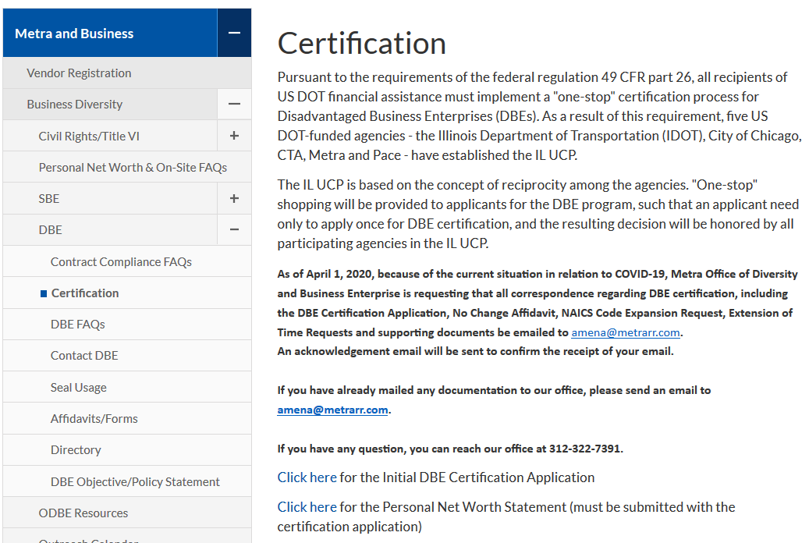
DBE Certification Application

Slide 10
Procurement Services
Presented by Carlos Ross, Sr. Buyer

Slide 11
How We Buy
Metra’s purchasing is handled by Procurement Department
Materials & Services Procurement Department:
Responsible for the purchasing of materials, services and equipment
Professional Services Procurement Department:
Responsible for contracts for architectural and engineering, financial and other professional services
Construction & Facilities Maintenance Department:
Responsible for contracts for construction and facilities maintenance services
Materials Department:
Responsible for the receipt, storage, distribution and replenishment of Metra's physical inventory

Slide 12
Examples Of What We Buy
Professional Services
Construction Related Services
Commodities & General Services
Architectural
Engineering
Human Resources
Financial
Marketing
Mechanical
Concrete
Electrical
HVAC
Masonry
Painting
Plumbing
Roofing
Chemicals
Equipment
Fuel
Furniture
Maintenance & Janitorial Supplies
Office Supplies
Rail Specific Items
Uniforms

Slide 13
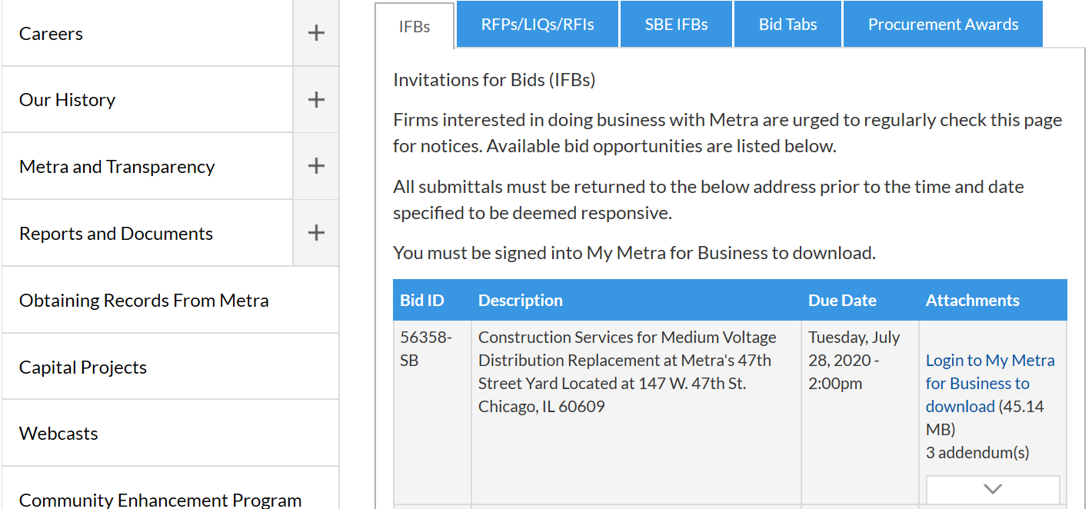
Contract Opportunities
Annual Procurement Plan
The Procurement Plan, updated quarterly, identifies potential contracting opportunities for goods and services anticipated by Metra Departments such as Engineering, Mechanical, Fleet and Facility Management, Finance, Information Systems and Materials and Stores. This document also includes information about vendor registrations and how Metra ensures that small, minority and women-owned businesses have equal opportunity to receive and participate in Metra contracts. Review Metra’s Annual Procurement Plan here.

Slide 14
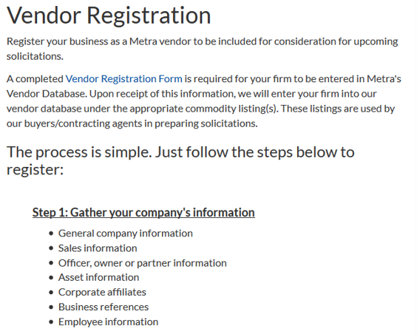
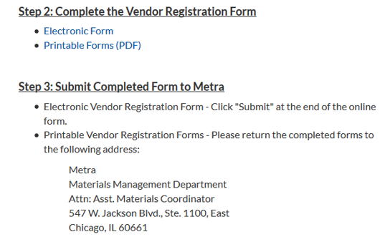
How To Register As A Vendor
Note: Please include the correct NAICS codes relating to the business or services provided to ensure you will receive solicitations from the
Procurement Department.

Slide 15
DBE Compliance
Presented by Ayanna Walker, DBE Compliance Specialist

Slide 16
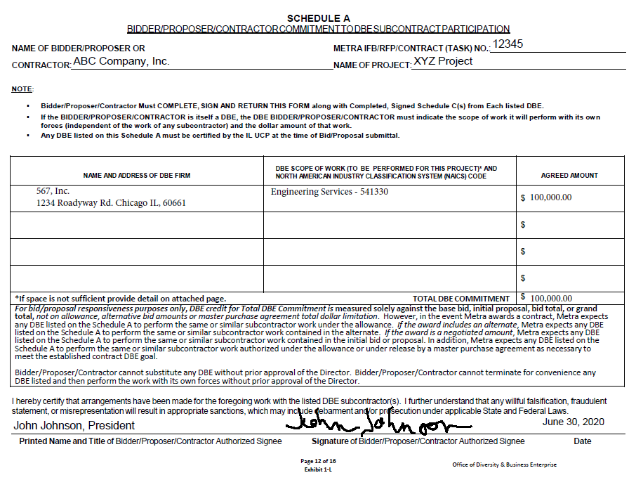
Bidders/Proposers
DBE Responsiveness Requirements
Schedules A (Commitment to DBE Subcontractor Participation)

Slide 17
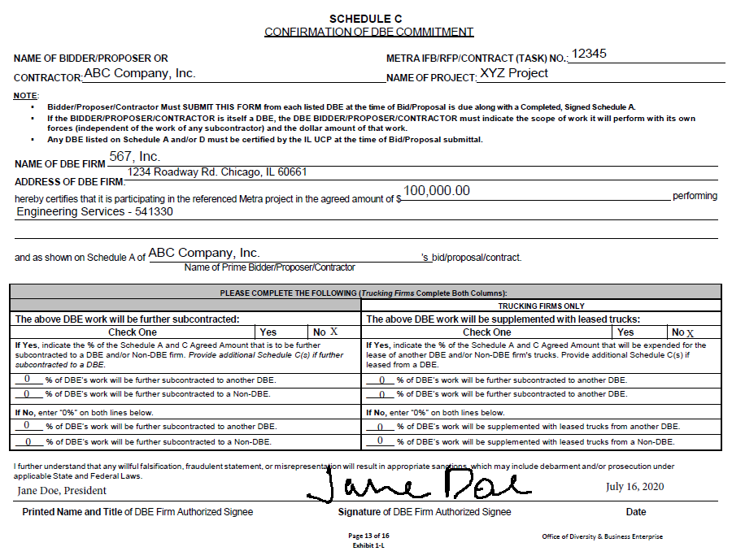
Bidders/Proposers
DBE Responsiveness Requirements
Schedules C (Confirmation of DBE Commitment)

Slide 18
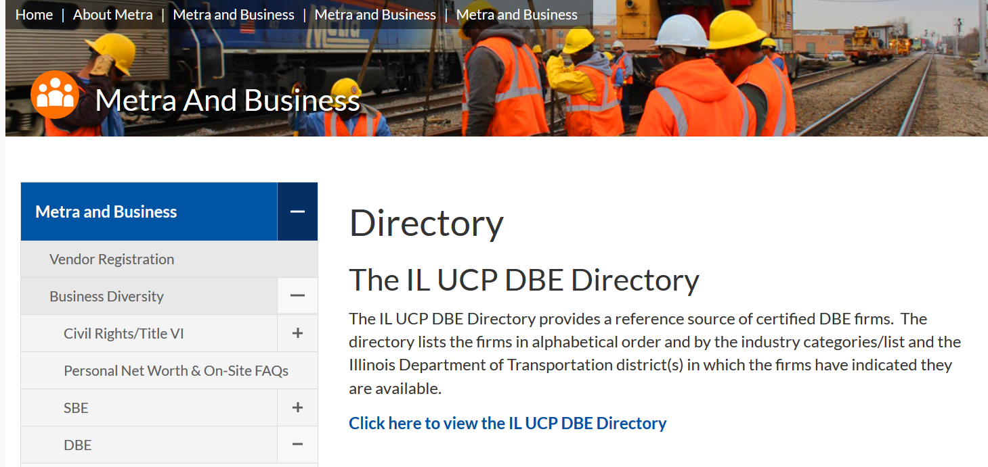
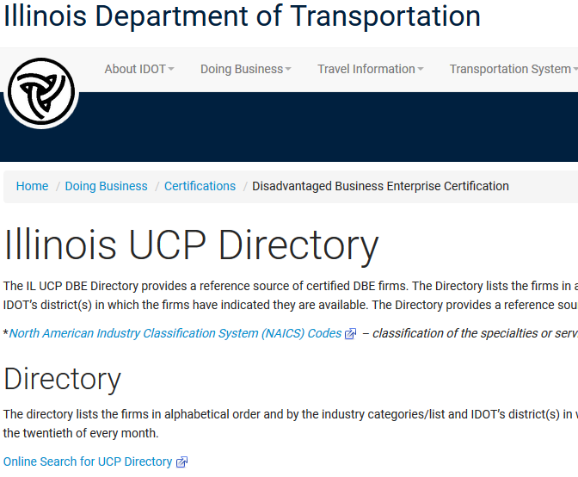
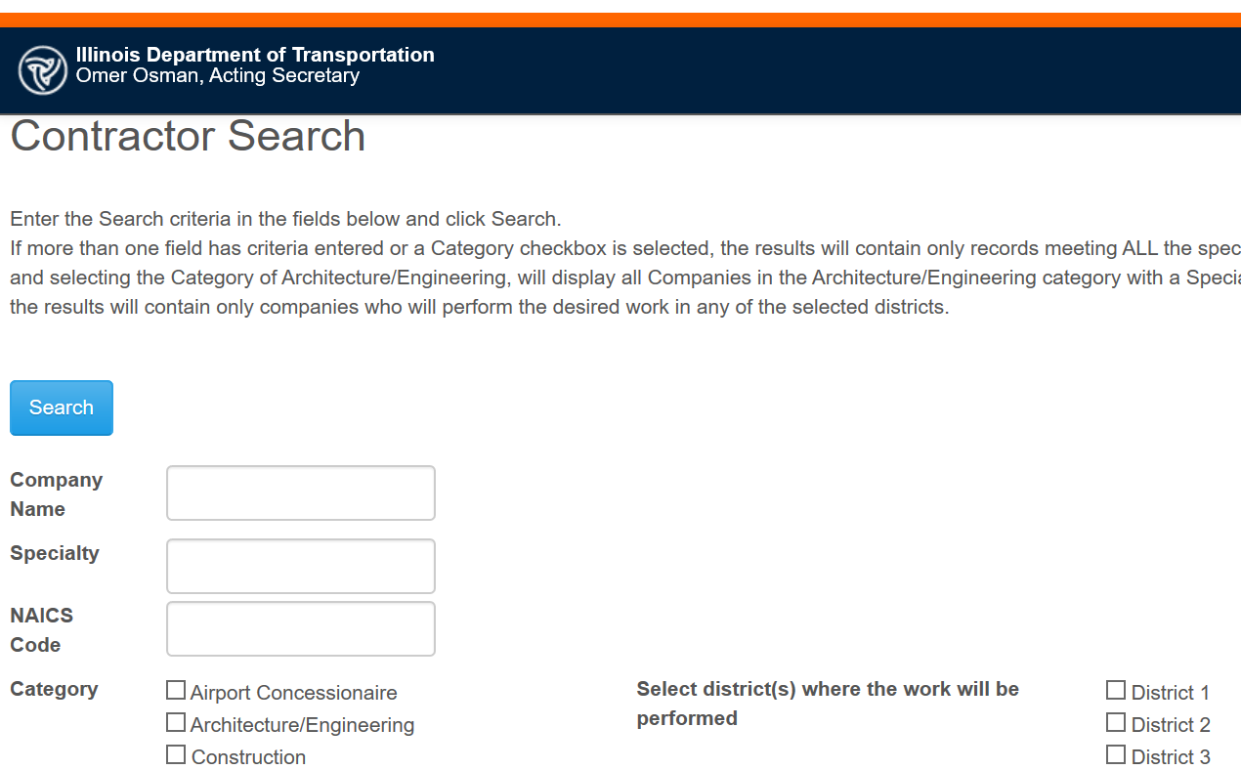
Locating Certified DBE Firms
1
2
3

Slide 19
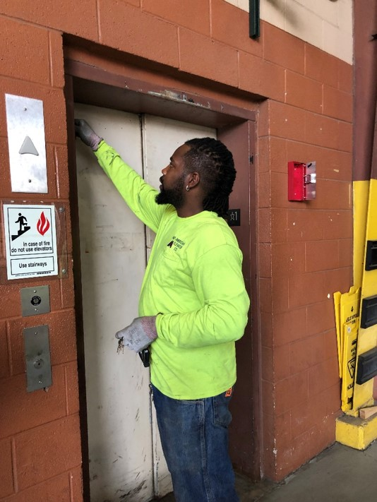
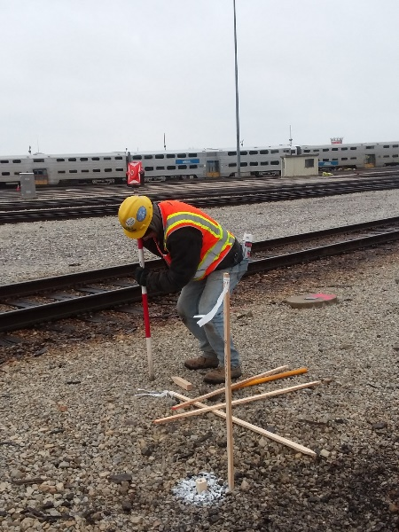
Contract Compliance Requirements
DBE Subcontract(s)
Invoice/Pay Application
Subcontract Payment Log
Proof of Payment
Worksite Visit

Slide 20
QUESTIONS
Contact Information
DBE Certification: Michele Sutton (msutton@metrarr.com)
Contract Compliance: Ayanna Walker (awalker@metrarr.com)
Office of Diversity & Business Enterprise: (metradbe@metrarr.com)

